Slide 1
Portal Concept Game Dev
2024-06-10 start

Slide 2
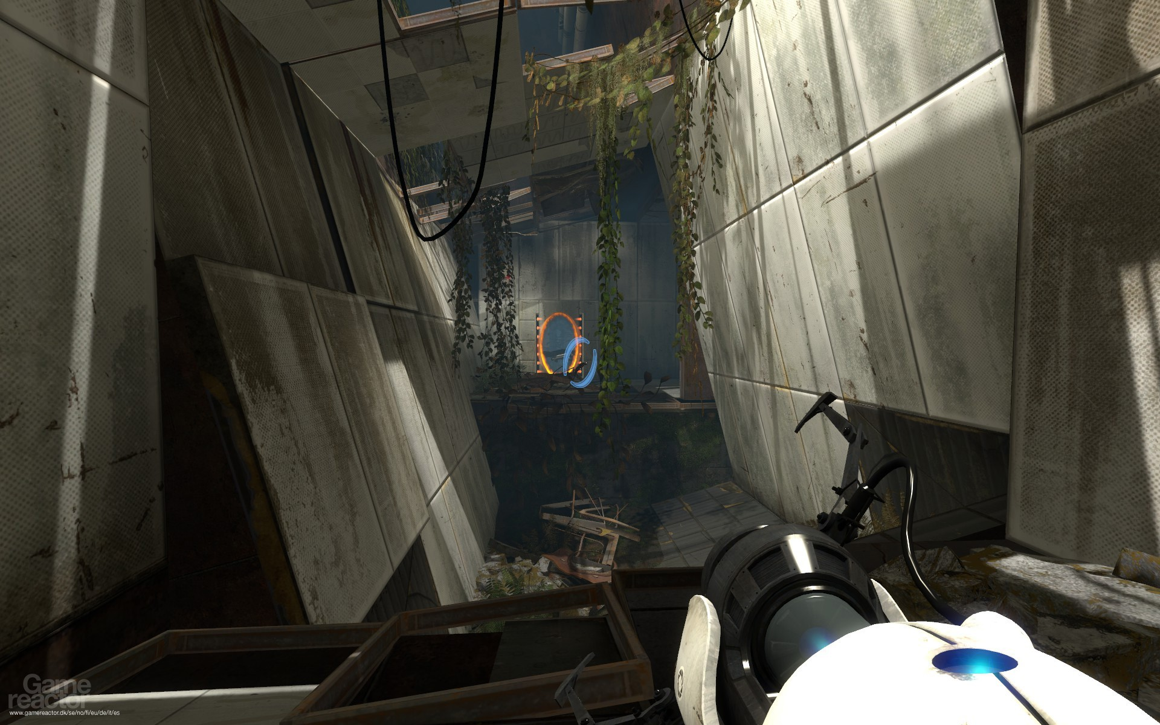
Fps camera 스타일

Slide 3
